Slide 1



”
By failing to prepare, you are preparing to fail.
Benjamin Franklin
Proposal to serve [CLIENT]
Business Impact Analysis and Disaster Recovery Gap Analysis
April 9, 2020

Slide 2




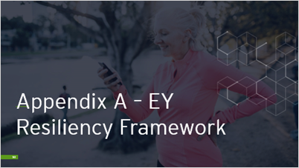
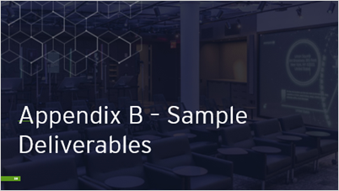
Contents
*Click the icon to take you to the desired section during presentation mode.

Slide 3
Executive Summary

Slide 4



Our understanding of your needs
What are we solving?
EY offers:
[CLIENT] is seeking to improve its IT disaster recovery (DR) posture by understanding the current business requirements for supporting applications and identifying the recovery gaps for mitigation.
We know your business and the health sector
[CLIENT] is a priority for us. EY has demonstrated, through over 10 years of partnership, our commitment to bringing you the right insight, guidance and talent. We have a proven methodology from our years of experience in the health sector tailored to [CLIENT]’s organizational needs and culture. Our goal is to position [CLIENT] for long-term success by promoting knowledge transfer and cross-training throughout this BIA and DR initiative.
Inconsistent criticality definitions
There is currently a lack of alignment between the business and IT’s definition of critical and time-sensitive as it relates to recovery prioritization during a disaster.
Outdated recovery objectives
Past business impact analyses (BIA) were performed inconsistently and with limited participation from IT. There are currently a large number of mission-critical business processes that translate to unrealistic recovery objectives from a DR perspective.
We are globally recognized as resiliency thought leaders
Our highly qualified team brings together a blend of business continuity (BC) and disaster recovery (DR) experience and health sector knowledge. Our resiliency certified professionals are actively involved in industry publications and conferences, having led resiliency articles, white papers and speaking engagements. We provide our clients insightful and objective recommendations for DR architecture patterns and solutions as our capabilities are complemented by our alliances to help our clients maximize their current and future technology investments and drive better business outcomes.
Gaps in DR capability
The objective is to recalibrate and validate the recovery objectives, to perform gap analysis between the objectives and current capabilities, and to estimate remediation costs and timing to address these gaps.
Our integrated BIA and DR framework
Our integrated BIA and DR approach aligns business priorities with IT capabilities to drive practical, risk-informed investments in business and technical resilience. We have conducted many business impact analysis for large complex organizations like [CLIENT] and delivered accelerated business outcomes with reduced risk and IT costs. Our framework is based on leading practices and industry standards, including but not limited to: ISO22301, FFIEC, NFPA 1600, DRII Professional Practices, and ITIL Service Continuity Management.

Slide 5

Our understanding of your needs
Why is this important to [CLIENT] now?
As we navigate through uncertain times, organizations like [CLIENT] must understand its business and IT priorities now more than ever. Unforeseen disaster events have prompted organizations to re-evaluate their resiliency strategies as they shift resources towards mission-critical business capabilities, workforce and technologies.
[CLIENT] is undergoing business and IT transformation. [CLIENT] is enhancing its healthcare payer and provider services and modernizing its IT capabilities to the cloud. Ensuring that your organization is resilient throughout this transformation requires alignment between the business and IT. The business must prioritize its critical business capabilities through a BIA, and IT must align its DR strategies (including investments required) to mitigate those gaps. Together, the business and IT can optimize resiliency investments to mitigate the highest priority risks.
COVID-19 and technology resiliency
The current pandemic has presented a different kind of disruption.
Healthcare organizations are needing support to rapidly respond to changing operational demands, coupled with an ever-increasing customer call volume.
With a workforce mobilized from home, there is a disruption in the traffic flow patterns resulting in a substantial increase in the inflow into the corporate network.
The new levels of sustained concurrency in remote access to business applications and collaboration tools has overloaded consumption of technology services.
The expectations around availability of technology services are currently magnified. IT’s role in ensuring infrastructure technology is providing resiliency so that business can continue its critical operations is key for continuity, recovery and survival.
Business Resiliency Challenges:
False assumptions and expectations of IT’s ability to recover critical applications and data during a “black swan” event
Inflated business continuity scope that impacts other resiliency initiatives (e.g. cloud transformation, DR, 3rd party resiliency, etc.)
A diluted and ineffective resiliency capability vs. a practical, effective capability that targets the most critical business areas
IT Resiliency Challenges:
Incorrect assumptions about the business’s expectations for application and data recovery
Inflated DR scope and spend resulting from too many applications defined as “mission-critical”
Mis-scoped strategic initiatives (e.g. IT modernization/cloud strategies) due to inaccurate BIA data
Sub-optimal DR capabilities that exceed the business’s tolerance for downtime resulting in greater business impacts

Slide 6







Our approach
Step 2: Communicate with key business, IT and Procurement partners
Communicate with business owners to interview as part of the 2018/2019 BIA review, BIA-Lite and complete BIA.
Plan for executive business leaders communication ahead of the BIA validation sessions.
Establish the IT and Procurement stakeholders communication to collect IT infrastructure dependencies and IT cost data prior to gap analysis.
Step 4: Facilitate BIA & BIA-Lite
Review and calibrate the 2018/2019 BIA results for the 351 business processes through interviews/workshops.
Conduct a BIA-Lite for the 635 departments that were excluded from the prior BIAs.
Conduct complete BIAs for the most critical business processes identified during the BIA-Lite (up to 200).
Establish the enterprise critical path illustrating the re-calibrated business process and application tiers.
Step 6: Analyze DR gaps and estimate costs and timeline for remediation
Work with IT to perform a DR Gap Analysis by comparing applications reported in the BIAs and their assigned recovery tiers against current DR capabilities.
Work with IT and Procurement to establish cost estimates and timeline for remediation, and present the summary report to executive leaders.
Step 1: Initiate & manage the project
Perform project initiation activities prior to the project kick off such as project plan and governance with key participants, risk and change management, and quality assurance, data collection requests and key participant identification. Perform project management activities throughout the engagement such as, risk and quality assurance, status reporting, executive updates, cross training, and knowledge-transfer.
Step 3: Validate tiering, terminology, & framework
Establish and enhance resiliency tiering definitions across the business and IT through stakeholder interviews and documentation reviews.
Review and improve the current BIA framework and methodology to align with leading practices, ensuring impact over time and supporting application criticalities are included.
Step 5: Validate BIA results, priorities, & objectives
Conduct interviews with executive business leaders and their directs to calibrate the BIA responses as they are completed.
Confirm the criticality of the business processes to optimize DR costs by reducing the number of mission- and business- critical processes and the applications that support them.
Step 7: Final read-out to executives
Conduct an executive presentation summarizing the project activities, observations (pre versus post-calibration), enterprise critical path, DR gaps, and the remediation roadmap with estimated costs and timing.
Key Outputs
Project governance, status reports, quality assurance and initial data collect requests
Standardized resiliency definitions and tiers with additional depth, clarity, and alignment between the business and IT
Participant pre-read and communication for interviews, BIAs, validation and read-out sessions
Enhanced BIA framework and methodology to drive more consistent data collection
Calibrated 2018/2019 BIAs for 351 business processes
Validated business process inventory for the 635 departments in-scope for the BIA-Lite
Completed and validated BIAs for up to 200 critical business processes
Enterprise critical path with business process and application tiers, and DR gaps highlighted
Gap analysis report with cost estimates and timeline for remediation
Final report and read-out including executive summary, detailed findings, recommendations, and next steps roadmap

Slide 7
Estimated timeline and fees
The following timeline represents the estimated effort to bring all project activities to completion. Several activities will run in parallel as illustrated below. Our proposed timeline is flexible to adjust around holidays and vacations.
Apr | May |  |  |  | Jun |  |  |  | Jul |  |  |  |  | Aug |  |  |  |  | Sep- Dec | Jan 2021
Pre-engagement phase (investment from EY) |  | Weeks
 |  | 1 | 2 | 3 | 4 | 5 | 6 | 7 | 8 | 9 | 10 | 11 | 12 | 13 | 14 | 15 | 16 | 17
1: Initiate project
1: Manage the project (administration, governance, etc.)
Develop a project plan and governance
Conduct a kick-off meeting
Initiate data collection requests and identification of key business, IT and Procurement participants
Define project management approach
These project initiation activities are not incorporated into the proposal fee.
2: Communicate with participants
Participant pre-read and communication
3: Validate definitions
Revised BIA framework, definitions & tiering
4: Review & calibrate 2018/2019 BIAs
Calibrated 2018/2019 BIAs
4: Perform a BIA-Lite
Sub-set of processes for complete BIA scope
4: Perform a complete BIA
Enterprise critical path with recovery prioritization
5: Validate results, priorities & objectives
Validated process & application tiers
Summary report & presentation
6: Collect IT application & costing data
6: Assess DR gaps and estimate costs and timeline for mitigation
DR gaps with cost and timing estimates
7: Exec read-out
Professional fees & expenses
EY has developed our fees based on the key resources required to successfully deliver this work with consideration given to continuing EY’s longstanding relationship with [CLIENT]. Our proposed fees are $XXX - $XXX exclusive of expenses, which EY will invoice [CLIENT] for at actual costs, up to XXX%.
Our approach includes a pre-engagement phase before commencing the project is an EY investment, which will be two to three weeks prior to the official kick-off of each project at no cost to [CLIENT].
Legend
Project Activities
Key Outputs
Executive Read-Out Preparation

Slide 8






Our core team, combined with subject-matter resource insights, brings the proven experience you need to achieve your goals
[CLIENT]
EY
EY Responsibilities
Executive Sponsor
[NAME]
Director, IT Disaster Recovery
[NAME]
Engagement Executive
Amr Ahmed
Client Partner
Greg Pope
Accountable for overall engagement delivery quality and timely completion
Core Team
EY Extended Team of SMRs
Director, Enterprise Resilience Office
[NAME]
Engagement Lead
Prudence Marasigan
Business Continuity Management
Provides the overall direction and guidance on engagement delivery
Disaster Recovery Management
Project Stakeholders
Business Teams, IT, Risk
Engagement Manager
Alex Connor
Responsible for the overall engagement delivery development and timely completion
Cloud and Infrastructure modernization
Engagement Analyst
Nicole Brothers
Responsible for engagement execution (daily activities) and delivery
Health Sector
Full representative biographies can be found starting on page 25.

Slide 9
Our proposed [CLIENT]-EY team organization and project governance
Our proposed project governance structure with well-defined role and responsibilities:
Our proposed project governance is based on the premise that a successful BIA must be conducted in a collaborative manner.
As part of the project initiation phase (prior to the project kick off), the EY team will work with [CLIENT] project sponsors to identify the key project governance participants with well-defined roles and responsibilities.
The roles and responsibilities, including their estimated meeting frequency, for each group will be defined. For example, the project manager and the [CLIENT] DR team will meet more frequently and report up to the higher groups throughout the project.
EY will be responsible to collect, organize and deliver the BIA and DR gap analysis results. EY will depend on [CLIENT] to fully participate in the workshops, reviews and approvals. This project governance helps communicate those expectations to all involved.
Executive Sponsors
Establish the project management functions
Decision-making and sponsorship on final Steering Committee recommendations, and supported by project management team
Meeting Frequency – start; end; as needed
Project Management Team
Plan, track, and report progress
Identify, assess, and escalate risks and issues
Provide advice and recommendations to Steering Committee
Frequency – daily
Steering Committee
Leadership and Quality Assurance
Provide strategic guidance by scanning the environment, envisioning the future, and championing a successful outcome
Sets the tone for cooperation and is accountable for the completion of project objectives and each BUs’ shared vision
Decision-making on scope, approach, team, and budget
Decision-making on key risk and issue resolution actions
Meeting Frequency – milestone-based; sign-offs
Guide work and facilitate the overall collaboration and integration between business process leads and project management team
Consensus building across [CLIENT]
Provide guidance and preparation for project team meetings and report-outs to the Steering Committee
Key inputs, quality assurance, and acceptance of deliverables
Meeting Frequency – prep for SC Meetings; milestone-based
BIA and IT DR Teams
Participate in BIA workshops and technology interviews and provide the requirements and capability data
Review data for accuracy and engage with project management as needed before executive business and IT leader review and approval
Understand the enhanced BIA framework, methodology and resiliency definitions for ongoing activities
Frequency – ad-hoc during the project per pre-defined schedule
Business Process Leads
[CLIENT]’s business process leads will be identified and participate as the “BIA and IT DR Teams” above
For example, this includes the following departments and their business processes : Clinical, Digital Health and Analytics, [CLIENT] at Home, IT, Risk Management, Human Resources, Finance, etc.
These are resources within the business units who can describe, quantify, and qualify business process impact. They will also provide dependency data to those business processes.
For IT and Procurement, these are resources who can speak to [CLIENT]’s technology environment and associated costs

Slide 10
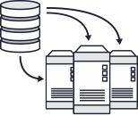
Sample BIA output Business critical path with application to business process mapping
The business critical path is a key deliverable of the BIA. It illustrates the enterprise recovery prioritization/tiering of the business processes mapped to the associated application dependencies.
In our experience, the critical path is a very effective way of summarizing the BIA results to executives because it:
Provides a strategic view to the leadership team to buy in on the prioritization
Gives a strategic/holistic view of recovery
Helps build a business case around how much/how little an organization should invest in recovery strategies
Helps prioritize your business continuity efforts by focusing on the most critical areas of the organization first and foremost
Business processes and applications in the critical path example on this slide could be further prioritized within each tier, based upon key criteria such as dependency and specific business impact (i.e. revenue) to allow for flexibility to restore the MOST critical processes/applications the soonest.
Mission Critical
(RTO <= n)
Business Critical
(RTO > n & <= n)
Business Important (RTO > n & <= n)
Business Supportive
(RTO > n)
BP 4.9
BP 4.11
BP = Business Process
BP 1.15
BP 3.10
BP 4.8
BP 1.7
BP 3.8
BP 4.10
BP 1.12
BP 3.4
BP 2.7
BP 4.7
BP 1.6
BP 3.6
BP 4.4
BP 1.11
BP 2.6
BP 1.4
BP 3.2
BP 2.5
BP 4.6
BP 1.3
BP 2.8
BP 3.5
BP 4.3
BP 1.5
BP 2.2
BP 1.1
BP 3.1
BP 2.1
BP 4.1
BP 1.2
BP 2.3
BP 3.3
BP 4.2
Business Func#1
Business Func#2
Business Func#1
Business Func#3
Business Func#2
Business Func#4
Business Func#1
Business Func#2
Business Func#3
Business Func#4
Disaster Declaration / Business Interruption
Enterprise Critical Path
App101
App238
App141
App392
App204
App401
App150
App241
App301
App418
App102
App239
App142
App393
App205
App403
App151
App242
App303
App419
App103
App240
App146
App397
App214
App408
App152
App243
App305
App420
App110
App250
App148
App399
App215
App411
App153
App244
App306
App421
App111
App251
App160
App216
App416
App154
App245
App307
App422
App120
App261
App167
App217
App417
App155
App246
App308
App423
App121
App265
App168
App243
App156
App248
App309
App122
App266
App169
App247
App157
App251
App310
App126
App181
App249
App158
App252
App311
App130
App189
App250
App159
App253
App312
Resiliency Capabilities:
No Gap
Misalignment
Gap

Slide 11
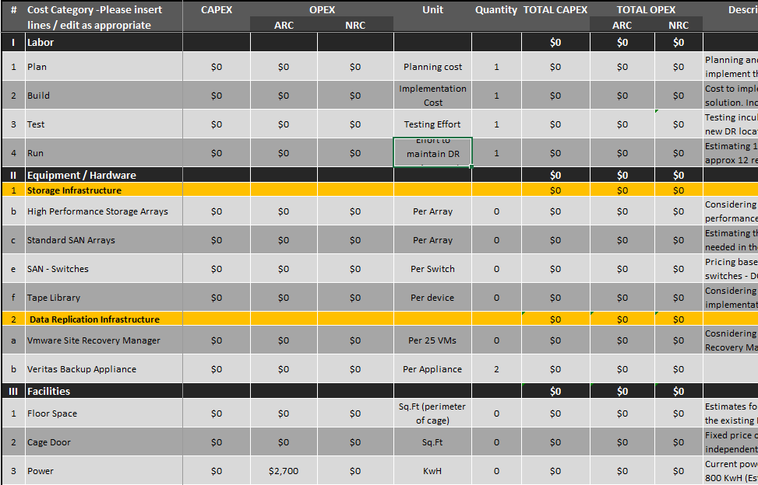
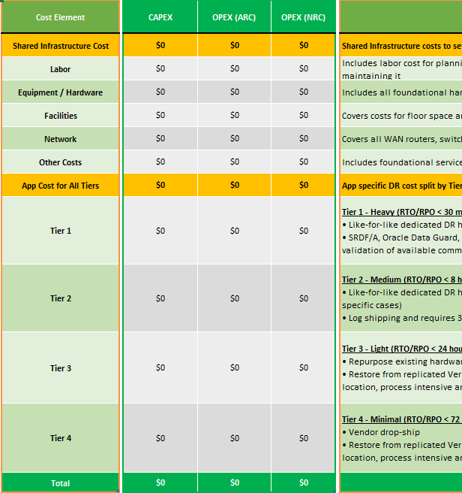
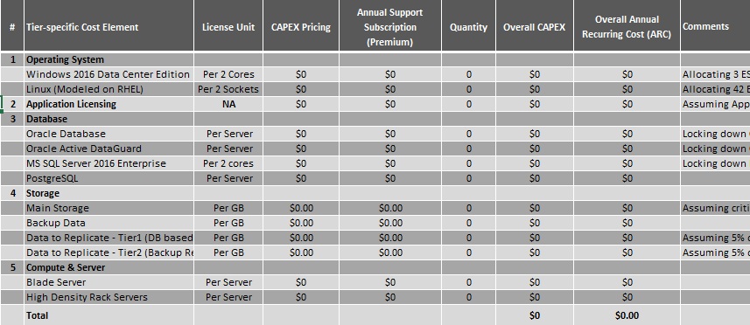
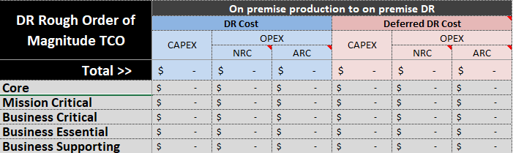
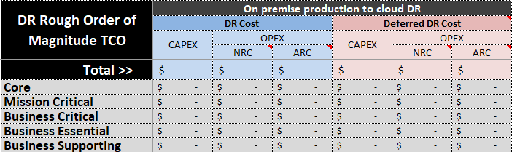

Sample DR gap analysis output DR cost model including CAPEX and OPEX for various recovery solutions
The DR cost model is an outcome of the DR gap analysis. As we review the gaps between applications RTO/RPO and existing capabilities, we will develop recovery options and mapped these options to each application based on criticality tiers, architecture pattern and technology platform.
The IT cost model will provide a rough order of magnitude (ROM) estimate of the DR costs to mitigate the gaps. These estimates and model will be helpful when evaluating the various DR options and articulating the business case for closing recovery gaps and risks.

Slide 12
Detailed Approach

Slide 13
Step 1 – Initiate and manage the project
Activity Overview
Perform project initiation activities prior to the project kick off such as project plan and governance with key participants, risk and change management, and quality assurance and data collection requests. Perform project management activities throughout the engagement such as, risk and quality assurance, status reporting, executive updates, cross training, and knowledge-transfer.
Approach and Tasks
The key tasks involved in this activity include:
Develop a project plan detailing the activities and milestones of the project
Establish the project governance structure by identifying the roles and responsibilities of the different groups required to conduct a successful project and the [CLIENT] and EY resources who will participate
Coordinate with [CLIENT] to drive a disciplined project management approach, supported by tailored templates and integrated within a variety of existing [CLIENT] project management tools as needed. EY will utilize the following project management key enabler throughout the engagement:
Planning and milestone management
Status reporting including progress dashboard, issue, risk, dependency, etc.
Governance, communications, and stakeholder management
Quality management
Change management
Conduct a kick-off meeting with the project stakeholders to present and confirm the engagement team governance structure, objectives, scope, timelines, success criteria, data collection requirements, assumptions, and methodologies that will be used
Begin collecting relevant project documentation (e.g., [CLIENT] org charts, resiliency frameworks, past BIAs, etc.)
Coordinate with the [CLIENT] business teams in the identification of key stakeholders for the BIA and the BIA-Lite workshops and IT and Procurement for the DR gap analysis
Start categorizing and grouping the BIAs completed in 2018/2019 and the departments for a BIA-Lite into workshop sessions that will be conducted together. EY’s approach is to complete multiple departments or processes in one workshop.
Support knowledge transfer and cross-training with [CLIENT] DR and BC stakeholders throughout the project
Value to [CLIENT]
An organized project with governance and communications protocols to effectively manage the activities; prep activities to enable the project team to hit the ground running on Day 1; knowledge transfer enable [CLIENT] to continue and sustain the BC and DR program efforts
Activity Outcomes and Deliverables
Kick-off presentation
Project governance model
Detailed project plan
Weekly status reports
Project tracker workbook
Document request list
Key business, IT and Procurement participants

Slide 14
Step 2 - Communicate with key business, IT and Procurement partners
Activity Overview
Communicate business owners to interview as part of the 2018/2019 BIA review, BIA-Lite and complete BIA.
Plan for executive business leaders communication ahead of the BIA validation sessions.
Establish the IT and Procurement stakeholders communication to collect IT infrastructure dependencies and IT cost data prior to gap analysis.
Approach and Tasks
The key tasks involved in this activity include:
Prepare the [CLIENT] business teams key stakeholders for the BIA and the BIA-Lite workshops and to understand:
Business owners mapping to their respective business processes from the 2018/2019 BIA or through initial discussions
635 departments that have not had BIAs completes in 2018/2019
Current resiliency capabilities and initiatives
Provide to the identified BIA stakeholders:
Pre-read, or “ask” that outlines for the participants the objectives, expectations, and pre-work necessary to complete prior to the workshops and interviews
Draft list of meetings, workshops, and interviews to be conducted which will include the objectives, meeting invite, and agenda
Prepare the [CLIENT] IT teams for the IT workshops to understand:
Application-to-infrastructure and dependency mapping information available
Available recovery requirements based on business functions and applications criticality (leveraging any BIA information, if available)
Core foundation infrastructure services (Tier 0, e.g., network, AD)
DR tiers based on services/applications recovery time and point objectives (RTOs/RPOs)
Current IT operations baseline, cost objectives, and growth projection
Current DR framework, recovery strategy, testing, and validation practices
Prepare the [CLIENT] Procurement team to collect any available current IT costs and Procurement tools to be used for the cost estimates
Value to [CLIENT]
Identifying and engaging the key business, IT and Procurement partners in the BIA and DR gap analysis workshops to provide relevant input and to promote BC and DR awareness across [CLIENT]
Activity Outcomes and Deliverables
Participants identified for the 2018/2019 BIA review, BIA-Lite, and complete BIA
Participants for the DR gap analysis, cost estimate, and timeline from IT and Procurement
List of data collection pre-requisites
Business and IT stakeholder list
List of meetings, workshops, and interviews with stakeholders
Participant pre-read and communication for interviews, BIAs, validation and read-out sessions

Slide 15
Step 3 - Validate tiering, terminology and framework
Activity Overview
Establish and enhance resiliency tiering definitions across the business and IT through stakeholder interviews and documentation reviews.
Review and improve the current BIA framework and methodology to align with leading practices, ensuring impact over time, and supporting application criticalities are included.
Approach and Tasks
The key tasks involved in this activity include:
Obtain and review current resiliency definitions to:
Understand [CLIENT]’s resiliency and tiering nomenclature such as Access to Care, Mission Critical, Business Critical, Business Significant, etc.
Identify misalignment between the business and IT definitions
Identify opportunities to bring additional depth and clarity to resiliency definitions
Develop recommended enhancements to base resiliency definitions
Interview business and IT stakeholders to:
Socialize recommended enhancements to base resiliency definitions
Align on resiliency definitions
Obtain and review existing BIA framework and methodology against leading practices to identify gaps
Update/Improve the BIA framework and methodology to align with leading practices, such as ensuring that:
Processes are defined at a consistent level (e.g., level 3)
Impact criteria (e.g., financial, regulatory, legal, student impacts) is included
Impact over time is included
Supporting applications and their criticality to the process are well defined
Value to [CLIENT]
Standardized terminology and consistent approach allows the BIA results to be compared across the organization and assists decision makers on where to invest in resiliency and DR
Activity Outcomes and Deliverables
List of data collection pre-requisites
Standardized resiliency definitions and tiers with additional depth, clarity, and alignment between the business and IT
Enhanced BIA framework and methodology to drive more consistent data collection

Slide 16
Step 4 – Facilitate BIA and BIA-Lite
Activity Overview
Review and calibrate the 2018/2019 BIA results for the 351 business processes through interviews/workshops.
Conduct a BIA-Lite for the 635 departments that were excluded from the prior BIAs and conduct complete BIAs for the most critical business processes identified during the BIA-Lite (up to 200).
Establish the enterprise critical path illustrating the re-calibrated business process and application tiers.
Approach and Tasks
The key tasks involved in this activity include:
Utilize the agreed-to resiliency tiering definitions and BIA framework and methodology for the 2018/2019 BIA review/calibration, BIA-Lite and complete BIA. Refer to appendix for a comparison of each BIA activity.
Review 351 critical business processes identified during the 2018/2019 BIAs with business and IT stakeholders to:
Build awareness of the enhanced BIA framework, methodology, and resiliency definitions
Validate and calibrate responses using the enhanced framework and definitions
Validate application and infrastructure dependencies with IT
Collect data points with IT (e.g., app owner, SLAs, hours of operation, maintenance schedule, technical dependencies)
Conduct a BIA-Lite for approximately 635 departments that were excluded from the 2018/2019 BIAs and quickly assess and identify critical business processes
Conduct pre-BIA and BIA-Lite workshop activities in preparation for a seamless workshop with the business, and post-workshop activities, including follow-up communications and clarification
Educate BIA-Lite participants on the enhanced BIA framework, methodology and resiliency definitions
Compile and prioritize the BIA-Lite results for leadership review (step 5) and decision on which processes require a BIA
Conduct a BIA for the most critical business processes that were identified in the BIA-Lite (up to 200 processes)
Follow the leading practice BIA framework and methodology to align with the revised and calibrated 2018/2019 BIAs. Like in tasks 2 and 3 above, BIA participants will be educated on the enhancements to the BIA methodology
Complete the BIA analysis:
Analyze the BIA information gathered to identify data gaps and anomalies for follow up data collection and validation
Conduct any remaining, follow-up interviews with the meeting participants as necessary to challenge the answers, fill-missing information, and/or provide more clarification
Develop the enterprise critical path illustrating the business process and application recovery tiers
Compile and prioritize the BIA results for leadership review (step 5)
Value to [CLIENT]
Enterprise-wide prioritization and tiering of business processes and applications to enable informed investment in BCP and DR strategies
Activity Outcomes and Deliverables
Calibrated 2018/2019 BIAs for 351 business processes
Business process inventory for the 635 departments in-scope for the BIA-Lite
Completed BIAs for up to 200 critical business processes
BIA data collection populated workbooks or uploaded into Archer
Enterprise critical path with prioritization including business process to application mapping

Slide 17
Step 5 - Validate BIA results, priorities and objectives
Activity Overview
Conduct interviews with executive business leaders and their directs to calibrate the BIA responses as they are completed.
Confirm the criticality of the business processes to optimize DR costs by reducing the number of mission and business critical processes and the applications that support them.
Approach and Tasks
The key tasks involved in this activity include:
Initial iterative BIA and BIA-Lite reviews:
As completed, following step 4 tasks, present findings of the calibrated BIAs and the identified business processes from the 635 departments
Gain consensus for the up-to 200 business processes to conduct follow on BIAs
Follow up on open items, direction, and additional content based on executive business leaders
Finalize the business processes prioritizations and dependencies (e.g., applications, 3rd-parties, interdependencies, sites, etc.)
Update the enterprise critical path business process and application recovery tiers
Conduct validation sessions with executive business leadership following completion of “Step 4 - Perform BIA and BIA-Lite”
Present resiliency tiers for the up-to 551 business processes (351 + 200) and application dependencies
Present additional BIA findings and insights from the interviews and data collection
Value to [CLIENT]
Executive leadership buy-in on the results of the BIA and the validated business requirements that IT can base their analysis and remediation efforts on
Activity Outcomes and Deliverables
Business leadership direction and agreement of the complete BIA scope (up to 200 business processes)
Reviewed and approved BIA documentation and findings
Revised enterprise critical path

Slide 18
Step 6 - Assess DR gaps and estimate costs and timeline for remediation
Activity Overview
Work with IT to perform a DR Gap Analysis by comparing applications reported in the BIAs and their assigned recovery tiers against current DR capabilities.
Work with IT and Procurement to establish cost estimates and timeline for remediation, and present the summary report to executive leaders.
Approach and Tasks
The key tasks involved in this activity include:
Interview and work with IT to:
Confirm the business and technical objectives of the engagement​
Understand current IT infrastructure environment, DR strategy, in-flight projects, constraints and operational processes​
Collect information on existing technology platforms, recovery architecture, and DR capabilities​
Collect any additional information on in-scope applications ​
Collect high-level information on DR program objectives, business requirements, planning, and testing​
Bon the BIA results, map applications on criticality tiers and perform a gap analysis comparing existing IT DR capabilities against business recovery requirements to identify recovery gaps
Input the DR data into the IT costing model to estimate the applicable cost by:
Collecting data from [CLIENT] IT and Procurement to support cost estimates
Develop cost estimates by aligning in-scope applications to DR options and infrastructure costs
Determine the estimated time to remediate based on the gap analysis, recovery options and cost model inputs
Conduct play back sessions and preliminary read-outs with IT SMRs, system owners, DR Lead, and Operational Leads to share findings and validate gap analysis report, cost estimates, and timeline
Update and enhance the gap analysis report based on feedback and additional data gathered
Revise the enterprise critical path to reflect application recovery gaps between business objectives and current DR capabilities
Value to [CLIENT]
A view of [CLIENT]’s application environment with identified DR gaps and the estimated cost and timeline to remediate those gaps
Activity Outcomes and Deliverables
Gap analysis report with cost estimates and timeline for remediation
Revised critical path with DR gap data points

Slide 19
Step 7 - Final read-out to executives
Activity Overview
Conduct an executive presentation summarizing the project activities, observations (pre versus post-calibration), enterprise critical path, DR gaps, and the remediation roadmap with estimated costs and timing.
Approach and Tasks
The key tasks involved in this activity include:
Develop and summarize the results into a final report, including:
BIA observations and findings including business process tiering, application dependencies, and other key insights
[CLIENT] critical path of business processes mapped to applications and recovery gaps
DR gap analysis and the corresponding recommendations, cost estimates, and roadmap
Socialize the final report with key stakeholders to inform them of presentation, including the key findings, risks, and areas requiring priority, as well as to solicit feedback
Finalize the detailed report based on feedback received through playback sessions
Conduct executive read-out meeting to present findings, the gaps, remediation, and next steps
Value to [CLIENT]
Executive leadership on the current business requirements, gaps in recovery, and decision for how to approach the next steps with cost and timeline to achieve future goals
Activity Outcomes and Deliverables
Final report and read-out including executive summary, detailed findings, recommendations, and next steps roadmap

Slide 20
Project assumptions
To perform the project activities, we have the following assumptions.
[CLIENT] will:
EY will:
Support getting the right resources to the table, will have BC and DR resources assigned on the project with EY.
Provide executive sponsorship and ownership for the project and will be available for issue escalation.
Assign a project coordinator who will assist our team in scheduling meetings and in navigating throughout the organization.
Provide knowledgeable business, IT and Procurement resources as active participants to the project activities.
Have DR technical architecture patterns and strategies in place aligned to criticality tiers.
Have IT team and Procurement responsible to provide:
Applications and infrastructure dependencies (e.g., system, storage, etc.)
Cost estimation tooling used by [CLIENT] Procurement teams
Review work products and provide comments no later than three days following their receipt by the project sponsor or designated reviewer.
Facilitate up to 30 BIA-Lite group workshops (up to 6 per week) with department leaders to define and prioritize high level business processes (level 2 or 3).
Each BIA-Lite group workshop will cover 20-25 departments.
BIA-Lite group workshops will last up to 2 hour and will include high-level identification of dependencies
Facilitate up to 20 complete BIA workshops (up to 4 per week) with business process owners for up to 200 critical processes identified during the BIA-Lite.
Each complete BIA will cover 10-15 processes.
Complete BIA workshops will last up to 3 hours and will include detailed data gathering of critical dependencies (e.g. applications, workforce and 3rd parties, etc.).
Not perform technical dependency mappings (automated or manual) for [CLIENT]’s IT environment.
Provide DR cost estimates to address DR gaps of the identified critical applications, using unit costs and tools provided by [CLIENT].
Estimate the costs to address gaps and align applications to DR strategy based on criticality tiers; EY will not be developing new DR strategies.

Slide 21
Case Studies

Slide 22









EY has significant experience helping companies through enhancing their business and IT resiliency
Large Health Insurance Company
Disaster Recovery Strategy Development
National Healthcare Company
DR Assessment and Framework Development
Global For-Profit, Higher-Ed Organization
BIA-Lite and BCM Program Governance
The client was challenged with identifying an enterprise-wide DR strategy to meet the business requirements for its mission-critical applications. EY conducted a BIA that compiled the prioritized business process and application critical path. EY interviewed over 50 IT application SMRs to understand existing DR capabilities these applications. EY conducted working sessions with IT infrastructure teams to understand the hardware and infrastructure recovery requirements, identified feasible DR strategies to support the mission-critical application recovery requirements as defined by the BIA. Lastly, EY developed a 3-year future state DR roadmap and business case for these applications.
The client sought EY’s assistance in validating and maintaining the relevancy and effectiveness of their disaster recovery program. EY reviewed the client’s IT DR SOPs, policies, and other pertinent artifacts against leading practices (e.g. ISO22301, FFIEC, DRII professional practices, ITIL ITSM) and identified gaps. EY also leveraged past BIA results and developed recommendations to enhance DR capabilities to achieve the desired, future, steady state. Using these recommendations, EY enhanced the IT DR administrative and maintenance plan and controls, including: DR program lifecycle, exercise scenarios, declaration and activation procedures, and the program health scorecard.
The client requested EY's help with maturing their enterprise BCM program and leading a rapid BIA-Lite effort. EY tailored impact criteria and criticality tiers based on the client’s business priorities. EY interviewed key stakeholders and process owners across the client’s organization to document recovery objectives (RTO/RPO) and dependencies (people, processes and technology). EY conducted workshops with the IT organization to evaluate their capability to satisfy the recovery requirements and identified DR gaps. EY also assisted in defining the BCM and DR program governance including policies, procedures, recovery strategies, operating model, and roles and responsibilities for the program.
Services provided by EY
Benefits realized
BIA-Lite
BCM governance and operating model
Recovery gaps and assessment
BIA and Critical Path Development
Disaster Recovery Assessment
Future State DR Roadmap
Disaster Recovery Assessment
Administrative & Maintenance Plan
DR Health check

Slide 23



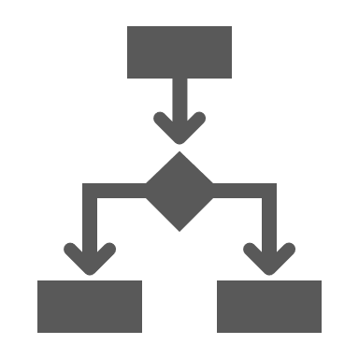

EY has significant experience helping companies through enhancing their business and IT resiliency
Leading Biopharmaceutical Company
Business Impact Analysis (BIA) Refresh
Metropolitan Transportation Authority
Business Impact Analysis and Disaster Recovery Strategy/Roadmap
Major Power and Utilities Company
Business Continuity Governance &
Disaster Recovery Architecture Blueprint
The client needed assistance refreshing their BIA, as the client’s IT did not have a clear understanding of the business requirements to build out cost effective DR solutions. EY conducted 30 BIAs to identify and prioritize business processes, and to identify application and data dependencies. This provided IT an inventory of systems and data dependencies mapped to the critical business processes, with RTOs and RPOs. These definitions enabled them to determine the appropriate recovery solutions that will meet the business’ requirements. EY established a Critical Path to depict a holistic view of the prioritized business processes and applications, based on potential impacts to the business.
EY conducted 53 BIAs across 25 departments, identifying 96 business processes and 195 unique applications. Business processes were prioritized and their critical dependencies, including the applications / services needed for recovery were documented. EY identified recovery gaps between IT’s capabilities and the business’s misaligned expectations. Further, EY defined a high-level DR strategy with next steps to implement and operationalize DR based on the business’s requirements and IT’s tolerance. EY also refreshed the client’s application inventory with additional characteristics and documented the BCM governance and framework that formed the structure to operationalize the program.
EY developed a BCM governance and framework and trained the client’s BCM team and the business unit resources on the custom ‘tool-kit’ of business continuity templates. Starting with a BIA, EY conducted a pilot BCM lifecycle. Leveraging the BIA data, EY discovered and documented application interdependencies (app-to-app, app-to-infra), and defined the criticality tiers for the applications and the dependent infrastructure. EY assisted the client to review the business recovery requirements as related to the IT environment. Further, EY reviewed the client’s current DR framework, recovery strategy, testing and validation practices, and proposed future-state DR strategy and implementation plan.
Services provided by EY
Benefits realized
Business Impact Analysis Refresh
Process to system mapping
Business Impact Analysis
BCM Governance and Framework
Business Impact Analysis and BCM Pilot
Process to Infrastructure Mapping
DR Strategy and Implementation Plan
Critical Path Development
DR Strategy and Roadmap

Slide 24
Representative Biographies

Slide 25
Our proposed team members deliver the right experience, knowledge and insights
Our team brings an innovative approach to business continuity and disaster recovery (DR) that has helped clients across various sectors, including health. Our core team and operating governance model has proven successful in similar large and complex business continuity management projects. Amr Ahmed will serve as the Engagement Executive. He brings extensive experience in managing risk for complex and large business continuity transformation programs. He will be supported by other EY executives from the [CLIENT] account and Health sector teams.
Amr will also be supported by the engagement lead, Prudence Marasigan. She has deep experience conducting BIAs and helping clients build resiliency programs through their associated activities. Prudence has worked on many similar engagements, including assisting clients liaise with IT teams to develop integrated resiliency strategies and roadmaps. Prudence will work closely with our EY teams at [CLIENT] to bring holistic and integrated insights to enhance the engagement’s approach and results.
Outside of our leads, we have highlighted representative bios of our core team and subject-matter resources on the following pages to demonstrate our level of experience in health care, life sciences, and business continuity. Subject-matter resources (SMRs) will be leveraged throughout the engagement to enhance the various activities and output developed by the core team. [CLIENT] will benefit from the experience, lessons learned and insights these professionals have gained from similar engagements.

Slide 26


[CLIENT] account leadership
Greg Pope [CLIENT] Coordinating Partner
greg.pope@ey.com
Abby Johnson Health Payer Leader
abby.johnson@ey.com
Background
Greg coordinates the services of EY to provide the best support to [CLIENT] and will continue to do so for this important initiative.
Relevant experience
He has worked with [CLIENT] since 2012 and has more than 20 years of business and IT consulting experience, with a focus on risk and large-scale business and IT transformation programs, assisting clients in health systems and health insurance/managed care, including both [CLIENT] and Kindred.
His experience with project delivery at [CLIENT] includes working with Internal Audit, Enterprise Information Protection, Information Technology, Procurement, and Strategy & Corporate Development.
Greg also serves as Office Managing Partner for Ernst & Young’s Louisville office.
Background
Abby is a Partner in the Health consulting practice. She contributes to a better working world by integrating EY capabilities to drive value to her healthcare clients. She has 17 years of professional services experience spent improving healthcare consumer experience and operational performance.
Relevant experience
Abby’s expertise lies in the analysis and improvement of health plan operational functions, across commercial and government lines of business.
Abby has led several efforts to improve consumer and provider experiences working with health plans and their acquired non-insurance business units.
Additionally, Abby leads EY’s Payer practice for the Central region, which affords her exposure to health plan strategies for growth, as well as the increasing risk of free market and governmental disruption driven by the untenable increases in the cost of care.
Abby is passionate about curating expertise and solutions from across our vast network of global and cross industry teams. She believes this will be increasingly vital to our clients, as the pace and scale of change in health continues to increase exponentially.

Slide 27




Core team members
Amr Ahmed Engagement Executive
amr.ahmed@ey.com
Prudence Marasigan Engagement Lead
prudence.marasigan@ey.com
Alex Connor Engagement Manager
alex.connor@ey.com
Nicole M. Brothers Engagement Analyst
nicole.m.brothers@ey.com
Background
Amr is the Infrastructure and Service Resiliency Practice Lead of Ernst & Young LLC. He brings over 25 years’ experience in business resiliency and information technology with an emphasis around business operation recovery, infrastructure strategy, modernization, and technology architecture solutions. Amr and his team focuses on leading practices for business continuity, disaster recovery, and crisis management services.
Amr and his team focus on leading practices for:
Crisis management, business continuity, business and operation recovery, integrated incident management and disaster recovery;
Data center modernization (e.g., technology platforms, public and private cloud, software-defined, workload mobility, etc.);
Intent-Based Networking (e.g., network transport services, zoning and segmentation, traffic engineering and service differentiation, collaboration services, inter-cloud connectivity, etc.); and
Amr is a frequent speaker regarding business resiliency, emerging technologies, data center solutions, infrastructure application resiliency, and network security architecture. He has presented at industry events such as Continuity Insights, FS-ISAC, Dell/EMC World, FutureNet and others.
Background
Prudence Marasigan is a senior manager in the Advisory Services practice of Ernst & Young LLP. She brings over15 years of experience in IT, focusing on business continuity Management, IT disaster recovery, and crisis management. Prudence supports clients with their infrastructure and service resiliency. She has presented at several Continuity Insights Management Conferences and has published white papers related to infrastructure recovery leading practices and trends.
Relevant experience
Facilitated a business impact analysis (BIA) for a large Midwest health care provider to define a risk-based prioritization of business processes and a defensible tiering of applications and support the decision-making relating to the allocation of capital and expense dollars for implementing disaster recovery strategies and data center design for their IT department.
Performed BIA-lite at a large telecommunication service company to understand critical business processes for two key products. Collected the dependency information on the people, locations, vendors, and technologies to define the service delivery and service assurance critical path. Developed the product level business continuity and disaster recovery plans for responding to large scale disasters and defined tabletop scenario narratives for validating the plans.
Background
Alex is a manager in the Advisory Services practice of Ernst & Young LLP. Alex has 10 years of experience in providing guidance on governance and framework, business impact analysis, business continuity planning, risk assessment, crisis management planning, disaster recovery planning, and business continuity training and awareness. He focuses on projects involving business continuity management, and disaster recovery management as well as technology transformation.
Relevant experience
Performed business impact analyses (BIAs) for multiple clients to help management identify critical business processes, recovery requirements, recovery time objectives (RTOs) and recovery point objectives (RPOs), and to determine potential financial and operational impacts if recovery times are not met.
Performed variance analysis to identify and possible gaps between bustiness needs and technology/process recovery capabilities.
Developed training and awareness materials for client’s business continuity program.
Assisted with scoping client’s five core asset classes into tiered priorities and performed risk assessments to understand the potential risks, threats, and likelihoods of impact for the highest risk assets.
Background
Nicole is a senior in the Advisory Services practice of Ernst & Young LLP. She has over four years of experience providing guidance on risk assessments, business impact analyses, tabletop exercises and business continuity planning. Nicole has helped clients in determining the impact of critical processes breaking down during a business disruption by conducting annual business impact analysis across their business units.
Relevant experience
Facilitated business impact analysis (BIA) project kick-off meetings for a major pharmaceutical company, and conducted dozens of BIA sessions with multiple departments. The BIAs identified and defined essential processes and their supporting applications, team members, processes, and other dependencies. These were then used as the foundation of business continuity planning efforts and department plan exercises.
Conducted a IT recovery gap analysis, developed program governance and framework documentation, as well as pilot BCPs and DRPs, conducted tabletop exercises to establish a BCM/DRM program, and assess applications for cloud fit for a state mass transportation agency.

Slide 28




Subject-matter resources
Eric Chiang Business Continuity and Disaster Recovery SMR
eric.chiang@ey.com
Nakia Washington Business Continuity SMR
nakia.washington@ey.com
Mounir Elmously Infrastructure and Storage SMR
mounir.elmously@ey.com
Abhi Shivapur Infrastructure and Network SMR
abhi.shivapur@ey.com
Background
Eric Chiang is a senior manager in the Advisory Services practice of Ernst & Young LLP. He brings 15 years of experience in business continuity, disaster recovery, and crisis management. Eric’s clients range from global Fortune 100 enterprises to middle-market companies across a number of industries, including, but not limited to, government and public sector, health care, life sciences, technology, and consumer products.
Eric has managed business relationships with stakeholders to help develop their knowledge and ability to efficiently respond to a business disruption. He focuses on helping clients with many important endeavors, including the review and enhancement of BCM methodology and framework, assessing and improving crisis management processes and procedures, performing business impact analysis (BIA), developing recovery strategies, and documenting business continuity, disaster recovery, and crisis management plans.
Background
Nakia Washington is a senior in the Advisory Services practice of Ernst & Young LLP. She has over 10 years of diverse experience in business continuity and disaster recovery and specialized training in management of projects (with business, technical and corporate input) ensuring deadlines and deliverables to meet client’s expectations. Nakia has worked closely with stakeholders to assist with the business continuity management program initiatives to conduct risk analysis, business impact analysis (BIA), recovery strategies, and plan maintenance.
Nakia has led workshops/interviews/questionnaires business impact analysis (BIA) for departments, as well as divisions for the client to identify recovery time objective (RTO), and recovery point objective (RPO) to prioritizes business process/functions, dependencies, applications, other factors defined by the business. She helps clients with identifying their risk tolerance to ensure they can effectively managed and/or reduce significant organizational impact.
Background
Mounir is a manager in the Infrastructure and Service Resiliency practice at Ernst & Young LLP. He has over 25 years of experience in IT with an emphasis around business continuity strategies and infrastructure technology architecture solutions. Mounir helps his clients with technical services that better align IT capabilities with the corporate strategy. He focuses on leading practices for business continuity and disaster recovery strategy services (build, consolidation and migration).
He has managed multiple business resiliency program, strategy engagements include program governance and business continuity and disaster recovery planning. These projects involved program operating model, resiliency strategy and business case, business impact and critical path and recovery priorities, incident response, communication planning, dependency mapping, and integrated recovery run-books.
Background
Abhi Shivapur is a manager in the Infrastructure and Service Resiliency practice at Ernst & Young LLP. He has helped multiple clients explore how technology can enable better operational and business resiliency. He has worked with clients in numerous industries such as technology, healthcare, education, government and public sector, and agriculture and has assisted them in the assessment, design, and improvement of their critical infrastructure processes.
Abhi has conducted business impact analysis (BIA) and Executive Impact Tolerance (EIT) across key business areas to identify critical business processes and the relative impact of downtime (measured as impact to revenue, customer experience, employees and other parameters). He focuses on developing infrastructure strategy and prioritized roadmaps, including value-cost analysis, resource estimation, and initiative timelines for modernizing organizational IT infrastructure.

Slide 29




Subject-matter resources
Tim Rehac Infrastructure and Cloud SMR
Tim.rehac@ey.com
Ramesh Balakrishnan Disaster Recovery and Technical Resiliency SMR
Ramesh.balakrishnan@ey.com
Joseph K. Oppong Healthcare Transformation SMR
jospeh.oppong@ey.com
Jeff Faulk IT Strategy and Transformation SMR
jeff.faulk@ey.com
Background
Timothy has over 25 years of experience in IT including 15 years of experience advising CIOs/IT Executives with a focus on leading Transformative change in IT. He has extensive IT Transformation experience consolidating IT to a Shared Service organization. Tim has also utilized Enterprise/Business Architecture to create IT Strategic Roadmaps for Business and Technology Domains.
During his tenure, he has led IT Strategy and Transformation initiatives focused on infrastructure to Public/Private/Hybrid Cloud environment, including Infrastructure automation, and orchestration through Software Defined Datacenter (SDDC).
Background
Ramesh has over 19 years of in-depth experience providing strategic guidance and advice on Data Center and IT infrastructure transformation, application rationalization, systems integration, outsourcing, program governance, and management.
Throughout his career Ramesh has successfully assisted customers in architecting complex IT infrastructure solutions, implementing several large-scale multiyear transformation programs and has been instrumental in providing guidance on setting up business continuity management program governance, process excellence, and system integration for highly complex IT Transformation initiatives.
Background
Joseph K. Oppong has 11 years of experience in strategic consulting around Clinical Alignment/ Transformation initiatives, Accountable Care Organization strategy/risk management framework and other business operational improvement initiatives.
He has extensive experience in helping companies align their strategic priorities to their risks and helping them manage the identified risks. Joseph has advised both payer and provider executives on ways to optimize their organizational design, governance structure, operating model, and technical capability to improve performance, enable growth, and reduce cost.
Background
Jeff is an IT Strategy & Transformation Technical Architect with over 20 years of experience in IT. Jeff has extensive experience advising CIOs/IT Executives and leading transformative change in the Financial Services, Manufacturing, Insurance, Utilities, Transportation & Logistics, and Retail sectors.
Jeff recently led an engagement for a global medical device manufacturing company to build a cloud reference architecture with a roadmap and supporting business case in transforming mission-critical lines of business to a hybrid cloud service model. The new cloud reference architecture formed the basis for reducing the delivery time for IaaS and PaaS services from months to minutes.

Slide 30
Appendix A – EY Resiliency Framework

Slide 31
EY Resiliency Framework
The EY Resiliency Framework defines common processes from which business continuity methods can be executed. The program life cycle framework includes:
The Strategize Phase — marks the beginning and the first half of the life cycle. It takes a risk-based approach to prioritizing business functions that are mapped to business criticality tiers. The end result is a recovery analysis which summarizes the identified business function recovery gaps, associated business risk and business recovery strategies.
The Mitigate Phase — continues the life cycle with strategy implementation and the development of business continuity plans and testing. This phase ends with the activities needed to sustain & maintain the program.
Mitigate
Strategize
Maintenance
Quality reviews and maintenance
Training and awareness
Communication plan
Metrics and compliance scorecard
Executive reporting
Change management
Plan
Program Planning
Program maturity assessment and annual roadmap refresh
Program budget and resource planning
Sustain & Maintain
[CLIENT] is here
Risk Assessment and Service Prioritization
Business impact analysis
Application impact and crown jewel analysis
Site and 3rd party risk assessment
Business dependency analysis
Technical dependency mapping
Business processes to technical capabilities mapping
Recovery gap analysis
Policy
Governance
Communication
Plan Exercise & Test
Pre-test
Conduct test
Post-test
Exercise & Test
Assess & Prioritize
Recovery Strategy Implementation
Recovery solution acquisition/build
Implement and enhance business and technical recovery capabilities
BC and DR plans
Incident response plan integration
Design
Recovery Strategy Development
Continuity and technical strategy options
Business case recommendation
Strategic roadmap development
Implement
BCM
DRM
BCM & DRM

Slide 32
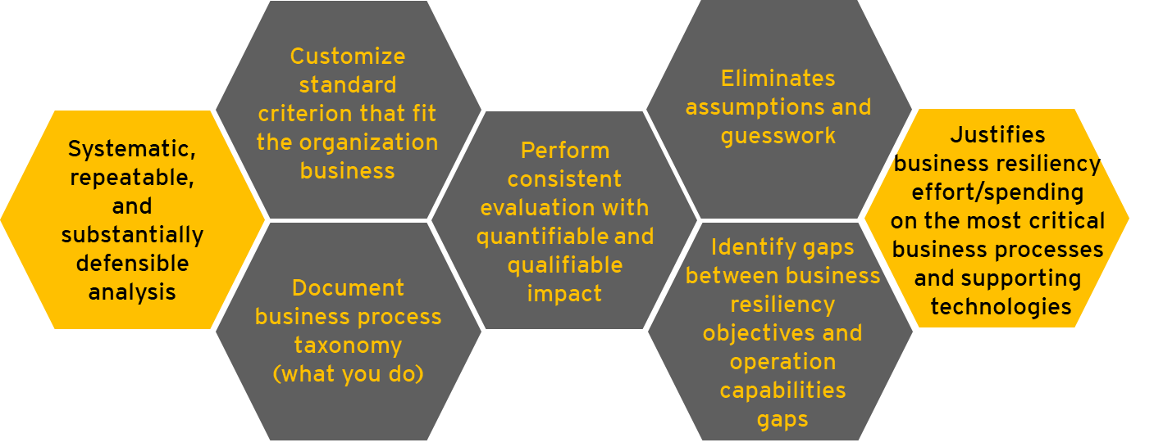
EY BIA Overview
The Business Impact Analysis (BIA) is a critical practice to identify potential business risks, criticalities and priorities tiers and its effect on achieving organizational resiliency goals and objectives, both from an operational, as well as a strategic, perspective.
Our success centers on the experience and competencies of our team that consists of experienced professionals who possess practical, hands-on BCM/DRM skills and experience, with expertise in enterprise Business Impact Assessments (BIAs) and implementation including large scale BCM programs. Our team’s BCM/DRM qualifications are confirmed by industry leading certifications, including but not limited to:
Certified Business Continuity Professional (CBCP, DRII)
Member Business Continuity Institute (MBCI, BCI)
Certified Information System Security Professional (CISSP, ISC2)
Certified Information Systems Auditor (CISA, ISACA)
ITIL (Information Technology Infrastructure Library) Foundation Certification v3

Slide 33
BIA Deliverable – BIA Verification vs. BIA-Lite vs. Complete BIA
As part of step 3, “Validate tiering, terminology, & framework”, the project will create an agreed-to, standardized BIA framework and methodology to assess business impact at [CLIENT]. EY will verify the results of the previous BIA and then move into the BIA-Lite and BIA .
For each of the these key activities a different number of business processes and departments will be reviewed and evaluated together. Starting in step 1, EY will work with [CLIENT] to determine the best way to group and categorize them to minimize the number of sessions any one [CLIENT] leader needs to attend but also provide the right mix of people in the room to challenge each other on the impacts and identify their dependencies.
For background, the BIA-Lite is a light version of the BIA effort to:
Establish a “quick hits” business processes criticality identification by senior executives
Develop a “holistic” view of the enterprise “critical path” relative to business processes and sites criticality that will be validated/refreshed in future BIAs
Key activities | BIA Verification | BIA-Lite | BIA
Project focus | 2018/2019 BIA results | Department level | Business process level from BIA-Lite output
Business process taxonomy | Level 4 and 5 | Level 1 and 2 | Level 3 – (Level 4 is optional)
Standard criterion | Revise previous criterion and standardize with BIA-Lite and BIA | High level BCM criticality tiers and Impact criteria definition | Detail BCM criticality tiers and impact criteria definition
Participants level | N/A | Business executive leader (e.g., BU leader) | Anyone that can quantify and qualify business process impact
Impact result final approval | N/A | CFO, COO or CEO | Business executive leader follow with CFO, COO or CEO
Meeting format | Review individual surveys inputted by participants in Archer and follow up workshops to close gaps | Individual Interview and/or workshop (1 – 2 hours) | Sub-business function workshop (3 – 4 hours)
Business impact data | Based on the data in Archer, the verification will review the data that was capturing inconsistently across years and business unit participants. Gaps and additional information will be captured as per the go-forward BIA framework and methodology | Capture high level impact data | Capture detail and substantially defensible impact data
Site/location risk |  | Optional (High level) | Detail site/location risk
Business process dependency |  | High level | Upstream and downstream business processes dependency
IT dependency |  | Application level only (optional) | Application and supporting infrastructure (e.g., network, system, storage, etc.)
3rd Party impact |  | Optional (High level) | Detail 3rd Party dependency

Slide 34
Strategy Framework
The development of disaster recovery design strategy for our clients is based on the framework below that takes into consideration the overall IT landscape including current and future IT strategies. The framework incorporates critical business and technical factors, priorities, key drivers, enterprise risk and security, technology dependencies and how all these components relate to the IT environment. Our approach to strategy development is technology-focused and business-relevant. With [CLIENT], we will leverage this framework to create the gap analysis. The numbers in green below indicate how.
EY will assist [CLIENT] with determining what will need to be recovered (#1) through the BIAs and how much it will cost to recover (#5) through the DR gap analysis and cost estimates.
Our assumption is that [CLIENT] has already defined how and where your DR environment will be hosted and recovered (#2 and #3) and the timing for when it will be implemented (#4).
Guiding principles
In-flight projects
Leading practices
Strategy inputs
Current state, gaps, and business and technical objectives
Work products
Requirements analysis and gap analysis
Leading practice solution recommendation
Business case & TCO model including actionable road map and plan
Business strategy & impact
What is to be hosted and recovered: people, business processes, and service/application critical paths for services, applications and information assets
How will it be hosted and recovered: technology and solution options including mapping to disaster recovery service tiers
Where will it be hosted and recovered: service zone, technology facility and sourcing options (if applicable)
When will it be planned: actionable short-term plan and long-term road map
How much it will cost: high-level budget requirements
1
Infrastructure strategy
2
Dependency & performance
3
4
Security & privacy
5
Business constraints
Technology constraints
People constraints

Slide 35
Appendix B – Sample Deliverables

Slide 36
BIA Deliverable – Impact Criteria
LOB Risk Tolerance Scale | Tolerance Levels:
Impact Criteria | Low | Medium | High
Financial | Minimal impact on actual revenue or actual cost | Moderate impact on actual revenue or actual cost | Adverse impact on actual revenue or actual cost
 | <= $50M impact on Operating Profit or Cash Flow | $50M <= $200M impact on Operating Profit or Cash Flow | > $200M impact on Operating Profit or Cash Flow
Process Financial | ≤ $10M impact on Operating Profit or Cash Flow | $>10M ≤ $50M impact on Operating Profit or Cash Flow | > $50M impact on Operating Profit or Cash Flow
Public Safety | Little impact to public safety, e.g. public safety is minimally compromised | Moderate impact to public safety, e.g. public safety is moderately compromised | Significant impact to public safety, e.g. public safety is significantly compromised
 | Minimal safety concern, limited or a single area or process | Safety concern to multiple areas or processes | Extensive safety concern, to most or all areas or processes
 | Minimal impact to ABC Corp. employee safety | Moderate impact to ABC Corp. employee safety | Significant impact to ABC Corp. employee safety
Customer Experience | Failures are isolated and limited to a small number of internal personnel | Failure limited to a small number of customers or one business relationship | Catastrophic failure impacting broad spectrum of customer groups, and distribution
 | Minor impact to customer satisfaction | Moderate impact to customer satisfaction | Severe impact to customer satisfaction
 | Disruption of service limited | Disruption of service is becoming apparent to customers | Extensive disruption of service
 | Minimal increase in customer loss anticipated | Moderate increase in customer loss possible | Extensive increase in customer loss probable
 | Ability to process new customers is compromised temporarily | Ability to process new customers is moderately delayed | New subscribers cannot be processed
 | Delays for customers and providers to speak live with customer service representatives are minimal | More wide spread delays to customers and providers to speak live with customer service representatives | Customers are unable to reach customer service representatives
 | Failures are isolated and limited minor impact to customer satisfaction with impact to < 15,999 riders | Moderate impact to customer satisfaction with impact to 16,000 - 80,000 riders | Significant impact to customer satisfaction with impact > 80,000 riders
Regulatory / Compliance / Legal | Minimal impact resulting from not meeting regulatory requirements | Moderate impact resulting from not meeting regulatory requirements | Severe impact resulting from not meeting regulatory requirements
 | Minor breach of regulatory or contractual obligations. No litigation. | Moderate Breach of regulatory or contractual obligations is confined to isolated incident(s). | Possibility of criminal action involving a felony against senior enterprise management or the company.
 | Little or no impact in ability to defend potential or existing lawsuits | Potential for increased regulatory scrutiny. | Severe breach of legal or contractual obligations
 | Ability to control damage with regulators | Potential litigation is limited. | Ability to defend potential or existing lawsuits severely impaired. Extensive penalties or fines possible
 | Little or no repercussions to the company. | Moderate Ability to control damage with regulators | Ability to control damage with regulators severely limited
 | The company is not subject to any fines or penalties for non-compliance to regulatory obligations | Moderate Repercussions to the company anticipated - the company has potential for penalty >50% chance, <$100K | Severe repercussions to the company anticipated - the company has likelihood of penalty <50% chance, >$100K
 |  | The company may come under increased scrutiny for failure to demonstrate compliance to regulatory obligations | Severe or widespread Privacy impacts to customers and employees
 |  |  | Loss of import / export privileges
Brand Image | Low visibility with little or no impact to company image | Moderate visibility with limited impact to company image | Major visibility with severe impact to company image
 | No or minimal reputation impacts. No or minimal impact on brand | Impact is isolated to a small group of existing customers. Damage is reversible. | Negative impact is national or global and is widely publicized
 | No or minimal loss of confidence in one of three groups of stakeholders – customers, business partners, employees | Moderate loss of confidence in stakeholders –customers, business partners, employees | Complete loss of confidence in three groups of stakeholders – customers, business partners, employees
 | Minor impact to customers' confidence in brand | Moderate impact to customers' confidence in brand | Major impact to customers' confidence in brand
Workforce | Little or no impact to employee morale, turnover, compensation/benefits and safety of workforce | Moderate impact to employee morale, turnover, compensation/benefits and safety of workforce | Severe impact to employee morale, turnover, compensation/benefits and safety of workforce
 | Minimal impact to the employee unions | Moderate impact to the employee unions | Major impact to the employee unions
The Impact Criteria determines the severity of each impact category for the organization. Each process owner should use these criteria to quantify or qualify impacts of an inability to perform their critical processes which will collectively result in the determination of a criticality classification and a related Recovery Time Objectives (RTO) for each process.
EXAMPLE

Slide 37
BIA Deliverable – Criticality Categories
Criticality Categories (Tiers)
The classification of processes and applications based on RTOs and RPOs into tiers are based on the categories defined in the table below. EY will review the existing application tiering with management as part of the BIA planning process.
Criticality Category | Recovery Time Objective (RTO)
 | Low | High
Tier 1: Mission-Critical | 0 | 12 hours
Tier 2: Business-Critical | > 12 hours | ≤ 48 hours
Tier 3: Important | > 2 days | ≤ 5 days
Tier 4: Supportive | > 5 days | -
EXAMPLE
Criticality Category | Recovery Point Objective (RPO)
 | Low | High
Tier 1: Mission-Critical | Near zero | 2 hours
Tier 2: Business-Critical | > 2 hours | ≤ 8 hours
Tier 3: Important | > 8 hours | ≤ 24 hours
Tier 4: Supportive | > 24 hours | ≤ 72 hours

Slide 38
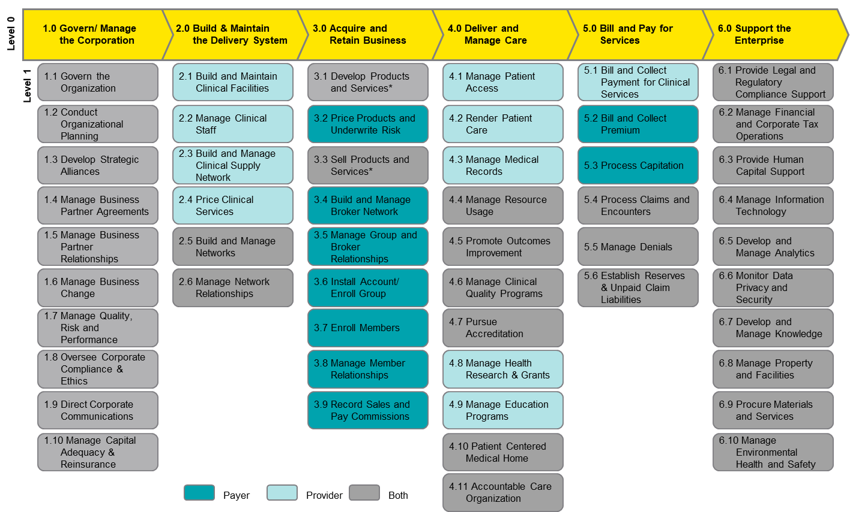
BIA Deliverable – Business Processes
Through steps 2-4, we will assess the business process taxonomy iteratively. Taxonomy refers to different “levels” of a process. Level 0 is the highest level and it goes down to level 5, the task level. The image to the right is am example of a business process taxonomy of the two highest levels for a healthcare company.
For the validation, BIA-Lite and BIA, the workshops will identify and document the business processes at the appropriate level.
If the processes from the 2018/2019 BIA identified are not accurate, are too high or too granular, they must be revised during the validation.
EXAMPLE

Slide 39
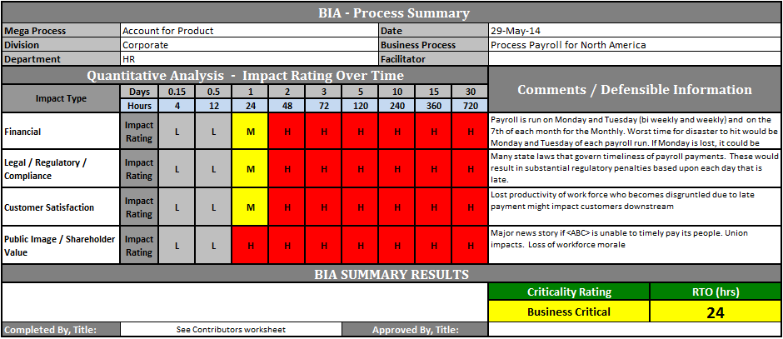
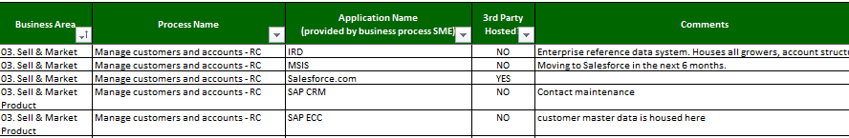
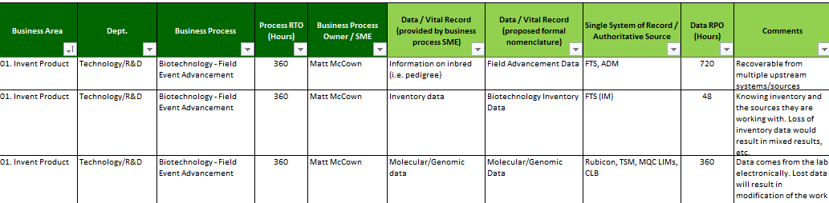
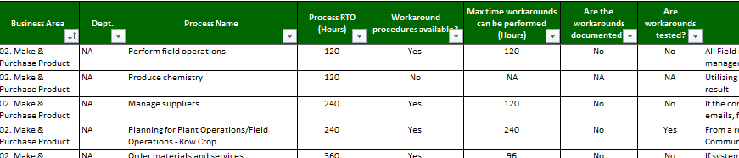
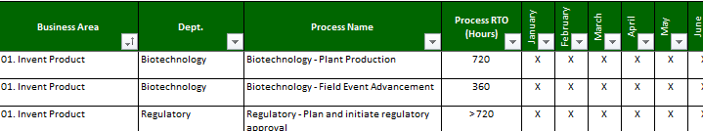
BIA Deliverable – BIA tool and data collection method
The BIA Data Collection Spreadsheet is used to facilitate the BIA workshop(s) and collect the impacts and dependencies for each of the business processes to define the recovery objectives.
EXAMPLE

Slide 40
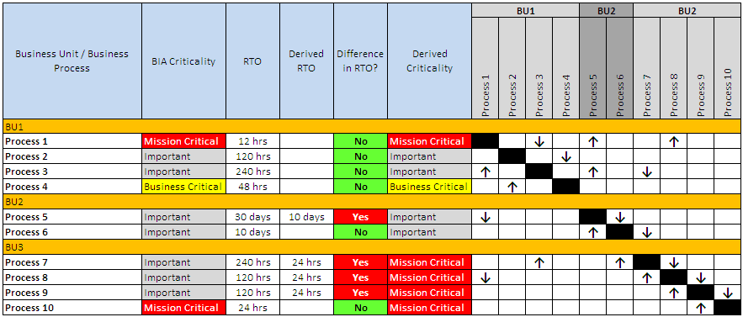
BIA Deliverable – Dependency mapping and site criticality
BIA includes mapping and analyzing dependent upstream and downstream processes to determine the recovery requirements to support the end-to-end business process.
EXAMPLE

Slide 41
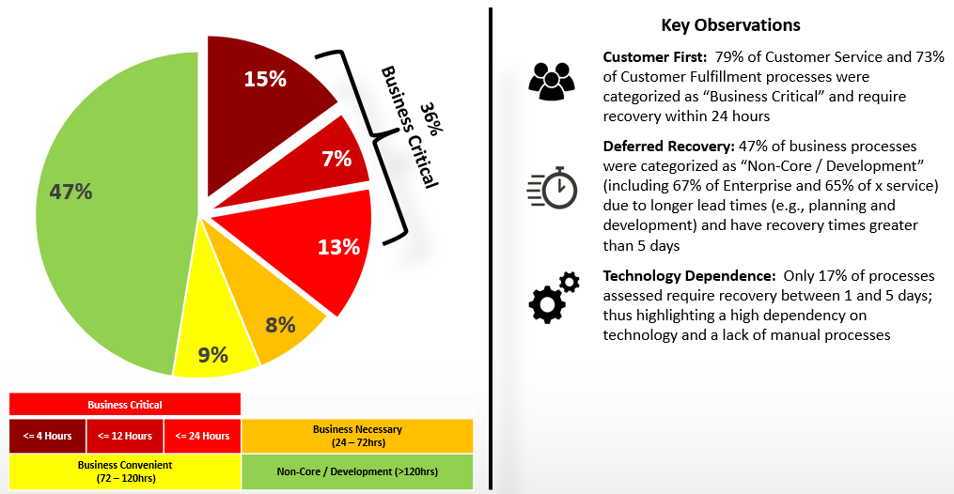
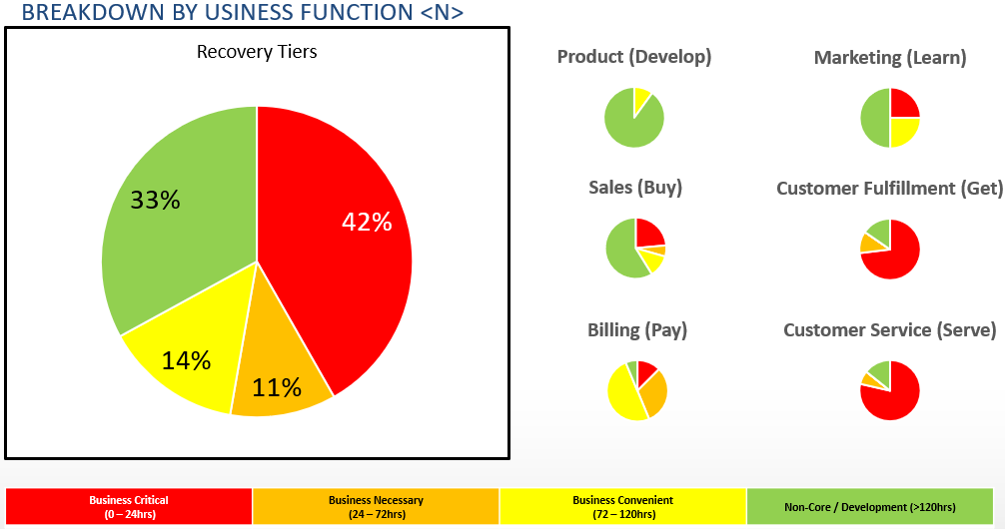
BIA Deliverable – Recovery Tiers
BIA results will be examined to review the number of business processes and applications in each criticality tier as an organization and in each business unit. EY will provide insight how these compare with peers in the same industry.
EXAMPLE

Slide 42
DR Deliverable – Gap Analysis – Business Requirements vs. IT DR Capabilities
Part of the BIA report and presentation to [CLIENT] management is the gap analysis which summarizes the existing recovery capability of the identified application dependencies.
The gap analysis is a detailed examination of the identified risks associated with the differences between business requirements (RTO/RPO) and the current available recovery capabilities
The analysis will serve as input in balancing these risks with the cost and benefits associated with the recovery solution to close the gap
BIA RTO and RPO vs. Current Capability
EXAMPLE
Application gaps by tier
Applications availability and data loss gaps
42

Slide 43
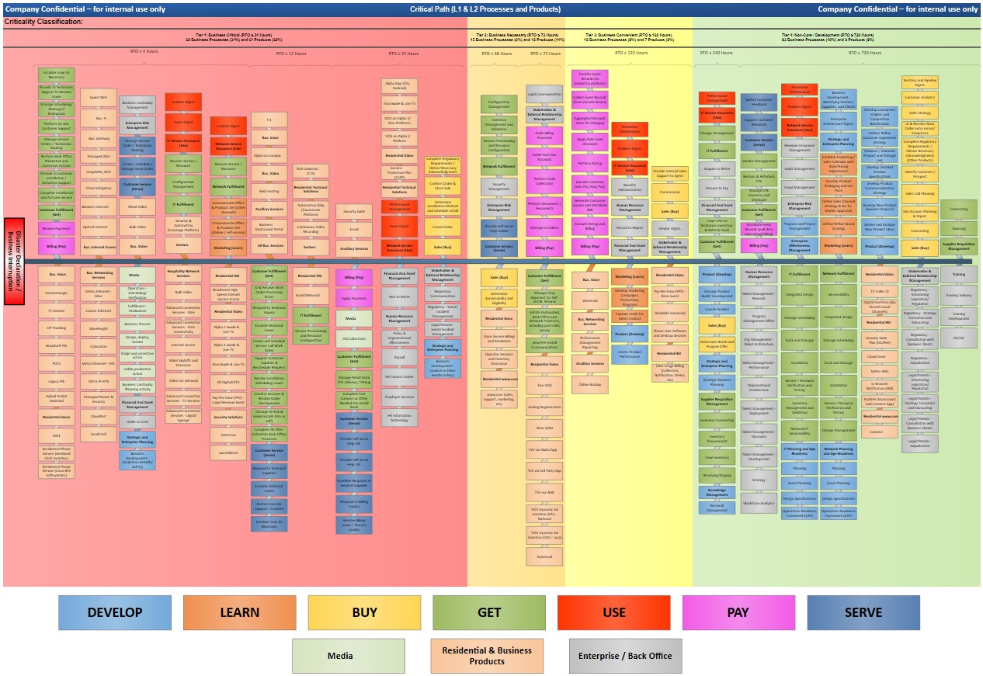
BIA Deliverable – Critical Path
This is another sample critical path with the recovery prioritization and tiering of the business processes organized by business functions.
EXAMPLE

Slide 44
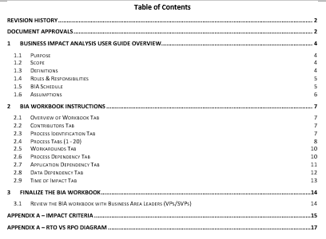
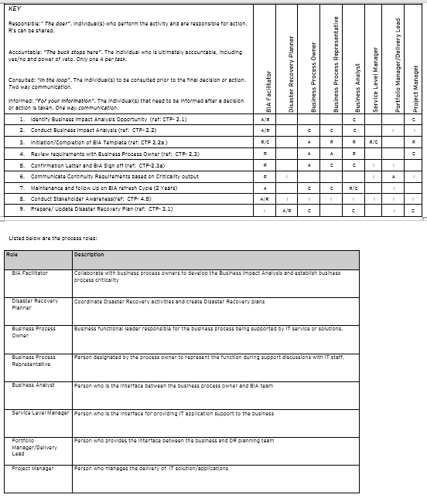
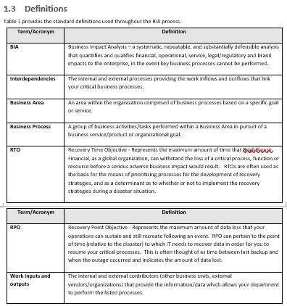
BIA Deliverable – BIA Facilitator Guide
The BIA Facilitator Guide is designed to assist BIA surveyors in completing the BIA survey, and to assist the surveyor in modifying/updating the survey tool.
EXAMPLE

Slide 45
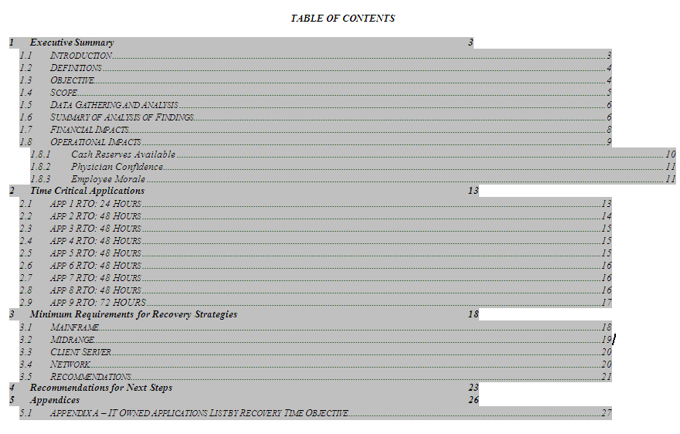
BIA Deliverable – BIA Report
BIA Report Table of Contents
The report is divided into five sections:
Section 1 is the executive summary which contains the project’s objectives, definitions, and a high level summary of the findings;
Section 2 documents a project overview including the purpose, scope, and assumptions as they relate to the project;
Section 3 provides an analysis of the time critical applications (as defined in this document) with a brief description of their purpose and potential impacts to the organization during an outage;
Section 4 documents the minimum recovery requirements; and,
Section 5 documents the recommendations for next steps. An appendix is included to provide the detailed information gathered from the accelerated Business Impact Analysis upon which this report is based.
EXAMPLE

Slide 46
EY | Assurance | Tax | Transactions | Advisory
About EY
EY is a global leader in assurance, tax, transaction and advisory services. The insights and quality services we deliver help build trust and confidence in the capital markets and in economies the world over. We develop outstanding leaders who team to deliver on our promises to all of our stakeholders. In so doing, we play a critical role in building a better working world for our people, for our clients and for our communities.
EY refers to the global organization, and may refer to one or more, of the member firms of Ernst & Young Global Limited, each of which is a separate legal entity. Ernst & Young Global Limited, a UK company limited by guarantee, does not provide services to clients. Information about how EY collects and uses personal data and a description of the rights individuals have under data protection legislation are available via ey.com/privacy. For more information about our organization, please visit ey.com.
Ernst & Young LLP is a client-serving member firm of Ernst & Young Global Limited operating in the US.
About EY Health
Around the world, the health sector is being reimagined in the face of aging populations, increased prevalence of chronic diseases, growth in emerging markets and shifting reimbursement models. Health care organizations must address these challenges while mastering the digital innovation that offers both opportunities and threats. Technology empowers patients, real-time analytics improves care and enables a mind shift toward prevention – but also opens the door to new non-traditional competitors. EY works with clients to reposition and optimize their business models, people strategies and operational structures to address cost pressures while leveraging the potential of analytics and technologies to improve quality of care. In this way, we help health organizations stay competitive and deliver better patient outcomes both now and in the future.
EY Global Health Sector brings together a worldwide network of more than 6,000 sector-focused assurance, tax, transaction and advisory professionals with a range of health care and business backgrounds. Our wide-reaching network allows us to rapidly share leading practices and solutions around the globe and deploy diverse delivery teams to meet your needs. ey.com/health
© 2020 Ernst & Young LLP.
All Rights Reserved.
This material has been prepared for general informational purposes
only and is not intended to be relied upon as accounting, tax or other
professional advice. Please refer to your advisors for specific advice.
ey.com

